Slide 1
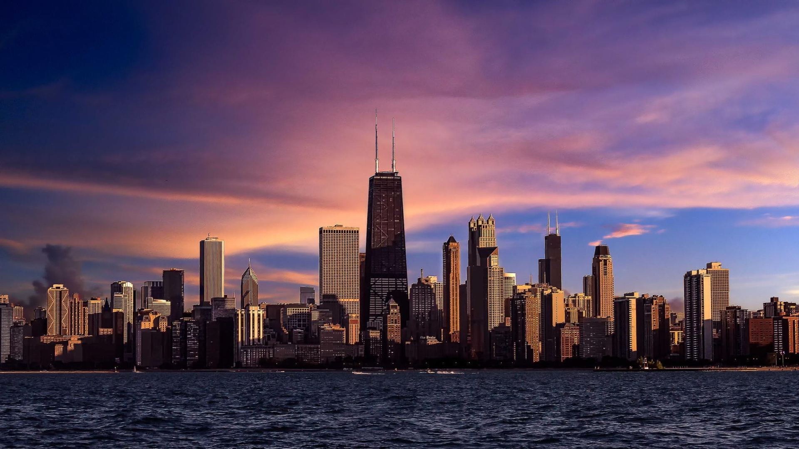


5000+
1600+
Latino students to enroll to AP CS
Chicago needs to get 5500 more 8th graders to advanced standards, and enroll 5,100 more Black and Latino students into AP Computer Science.
1842+
Black students to enroll to AP CS
409
Currently Enrolled black students
2251
Target Enrollment for black students
2638
Target Enrollment for Latino students
1025
Currently Enrolled Latino students

Slide 2

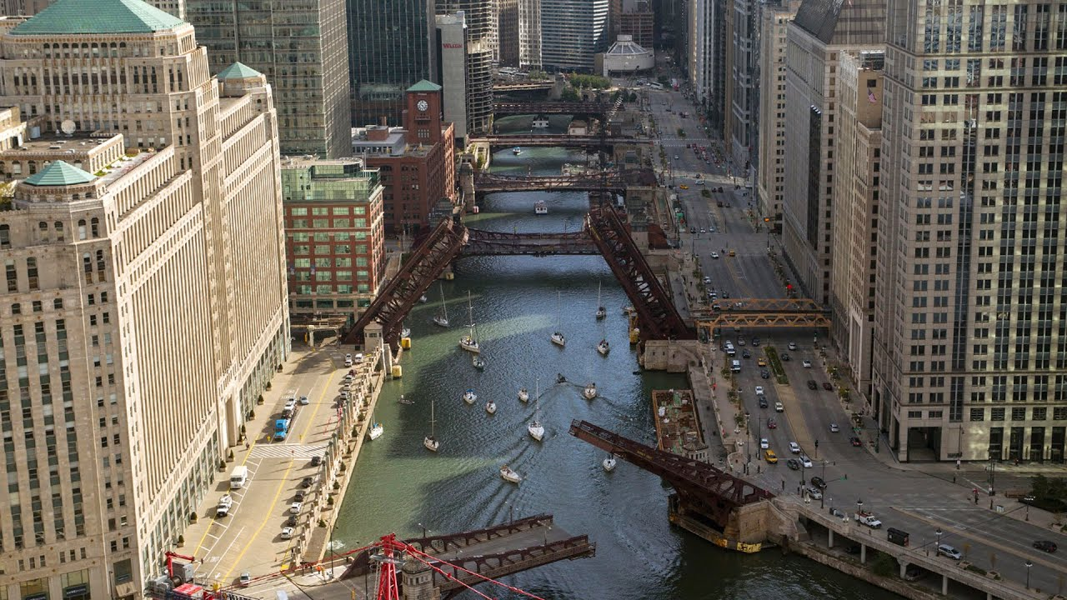
BRIDGE
THE
GAP
of math proficiency
at 8th grade
Chicago needs to ensure 9100 more Black and Latino 8th graders meet math proficiency standards to close the gap
4781
9000+
MORE
to
achieve equity level
Black and Latino 8th graders have
4781
Black and Hispanic
8th graders has
met math proficiency standard
met math proficiency standards
Target
13982
13892
Black and Hispanic
8th graders has
met math proficiency standard

Slide 3
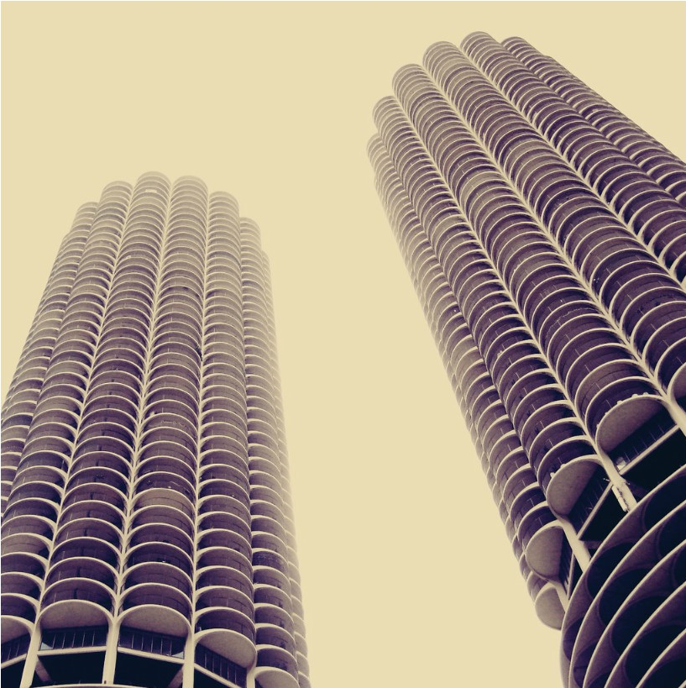
42% vs 22%
31%
Of IL high school graduates are Black or Latino
2,972
graduated in computing
56,333
graduated from high school
22%
of college graduates in computing
are Black and Latino
17,984
Black and Latino
647
Black and Latino
Race/Ethnic group | Population Size | Percent of Students that immediately enrolled into college | Where we are at |  | Total Gap
Black | 24399 | 33% | 8003 |  | 4929
Hispanic | 37382 | 27% | 9981 |  | 9831
White | 76460 | 44% | 33489 |  | NA
Asian | 7813 | 62% | 4860 |  | NA
IL college graduates in computing are 22% Black or Latino despite being 42% of all IL high school graduates

Slide 4



WIDDEN
THE
GATE
of computing program
IL college graduates in computing are 22% Black or Latino despite being 31% of all IL high school graduates
22%
Computing major graduates
Are Black and Latino
31%
High School graduates
Are Black and Latino

